Slide 1

Dynamic vs Static Routing Efficiency
Presented by : MOHAMED SYED THOWFIQ S (192511178)
KOTHAKOTA RAKESH (192525075)
GANGAVARAPUABHINAY REDDY (192525082)
Course : [ COMPUTER NETWORKS FOR COMMUNICATION ]
FACULTY : DR.ANANDH , DR.RAJARAM
Date : 04-08-2025

Slide 2
Table of Contents
Abstract
Introduction
Static Routing
Dynamic Routing
Efficiency Comparison
Advantages & Disadvantages
Conclusion

Slide 3
Abstract
This presentation compares static and dynamic routing based on:
Efficiency
Scalability
Real-time adaptability
We analyze their use in :
Small vs. large networks
Behavior during failures
And highlight :
Real-time examples
Advantages & disadvantages of each method

Slide 4
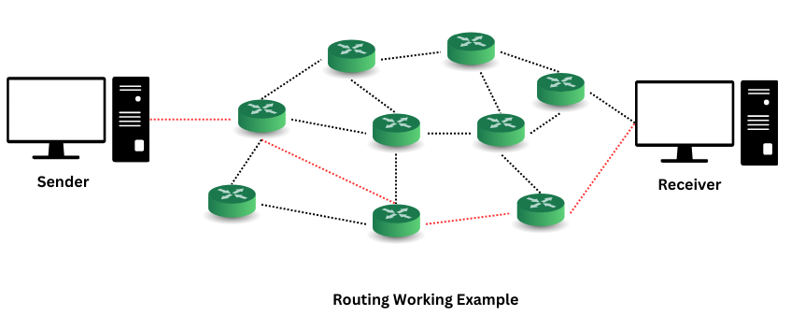
Introduction to Routing
Routing:
The process of selecting a path for data in a network.
It determines how data packets move from source to destination through routers and paths.

Slide 5



Why Compare Static and Dynamic?
Performance Understanding
Configuration & Fault-Handling
Optimal Approach
Choose the best approach for specific network sizes and goals.
Understand how each performs in real-time scenarios.
Evaluate configuration and fault-handling differences.

Slide 6
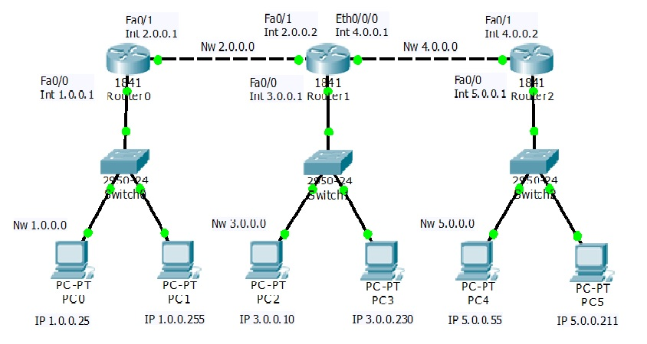
Static Routing – Definition
Routes are manually configured by the network admin.
Paths are fixed and do not change.
Best for small networks or simple topologies.
No communication between routers.

Slide 7

Static Routing – Real-Time Example
Example: A small office with two routers.
Fixed paths configured manually by an admin.
No need for dynamic updates because the structure rarely changes.

Slide 8
Static Routing – Pros and Cons
✅ Pros:
❌ Cons:
Simple setup
No automatic failure recovery
Secure (no route advertisement)
Manual reconfiguration required
No CPU/memory usage
Poor scalability

Slide 9
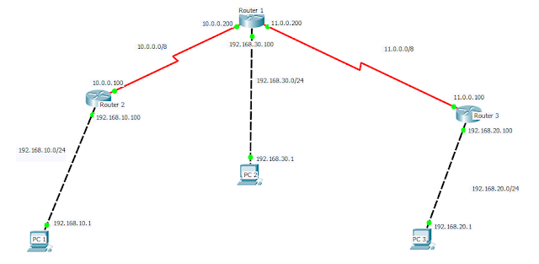
Dynamic Routing – Definition
Routers automatically share routing info.
Paths adjust as the network changes.
Uses routing protocols like RIP, OSPF, EIGRP, BGP.
Good for large, complex, or frequently changing networks.

Slide 10
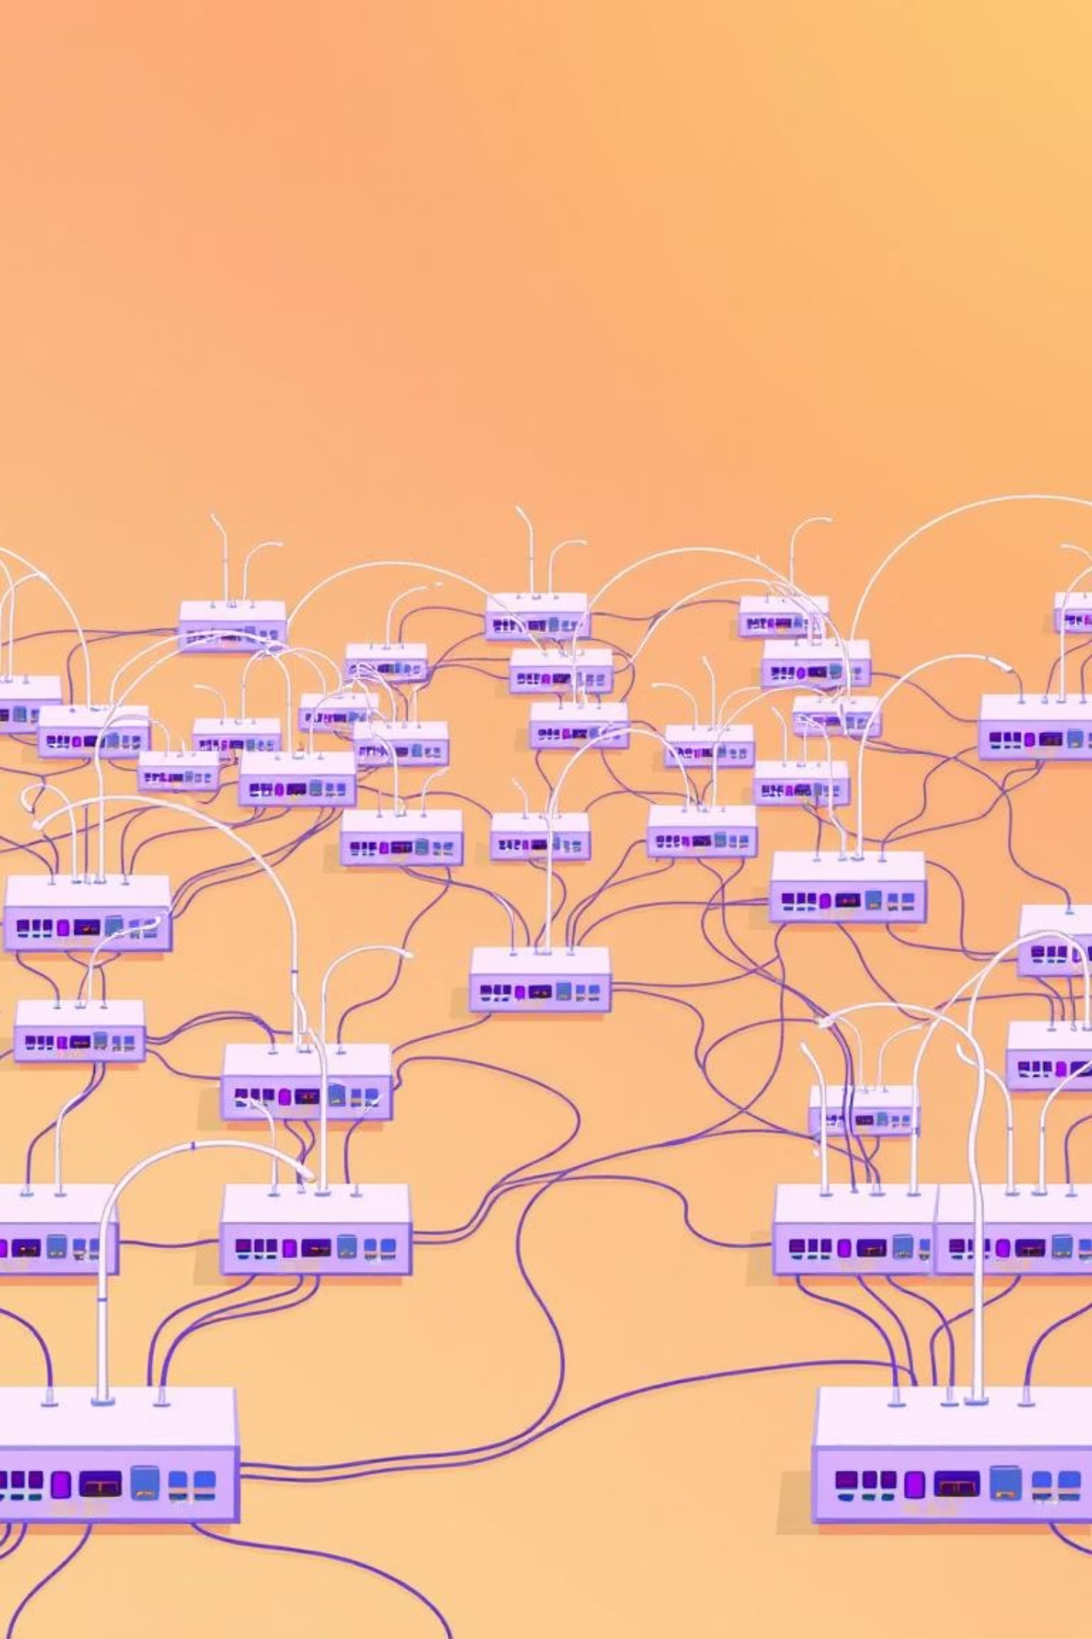
Dynamic Routing – Real-Time Example
Example : An Internet Service Provider (ISP)
Uses OSPF(Open Shortest Path First)
across hundreds of routers.
Automatically update routes when links go down or new routers are added.

Slide 11


Dynamic Routing: Advantages and Challenges
Pros
Cons
Automatically updates routing tables.
Consumes CPU and memory resources.
Scales well with large and growing networks.
Configuration and trouble shooting can be complex.
Adapts quickly to topology changes and failures.
Risk of routing loops if not configured properly.

Slide 13

Efficiency Comparison: Key Factors
Understanding the core differences between routing methods is crucial for network design.
We evaluate them across several key dimensions to determine their suitability for various environments.
Configuration method
Scalability
Fault tolerance and recovery
Cpu and memory resource usage
Use case suitability
Network complexity

Slide 14
Routing Efficiency : A Detailed Comparison
Feature
Static Routing
Dynamic Routing
Configuration
Manual
Automatic
Scalability
Low
High
Fault Recovery
None
Automatic
CPU/Memory Usage
Low
High
Use Case
Small networks
Large/dynamic networks
Complexity
Low
High

Slide 15
Key Takeaways & Future Directions
Static Routing
Dynamic Routing
Hybrid Approach
Best for small, secure, and stable networks.
Ideal for large, changing environments requiring automatic updates and fault tolerance.
Common in enterprises—leverages the simplicity of static routing and flexibility of dynamic routing.
Thank You! Questions and Discussion Welcome!
Presented by : KOTHAKOTA RAKESH , G ABHINAY REDDY , MOHAMED SYED THOWFIQ S
Course Name: [COMPUTER NETWORKS FOR COMMUNICATION] (CSAO735)
Date : 04-08-2025

